Slide 1

Strategic targeting of rich inflectional morphology for linguistic analysis and L2 acquisition / TROLLing for linguistic data
Laura A. Janda, UiT The Arctic University of Norway

Slide 2
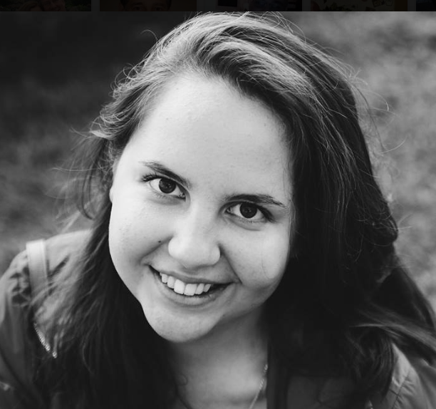

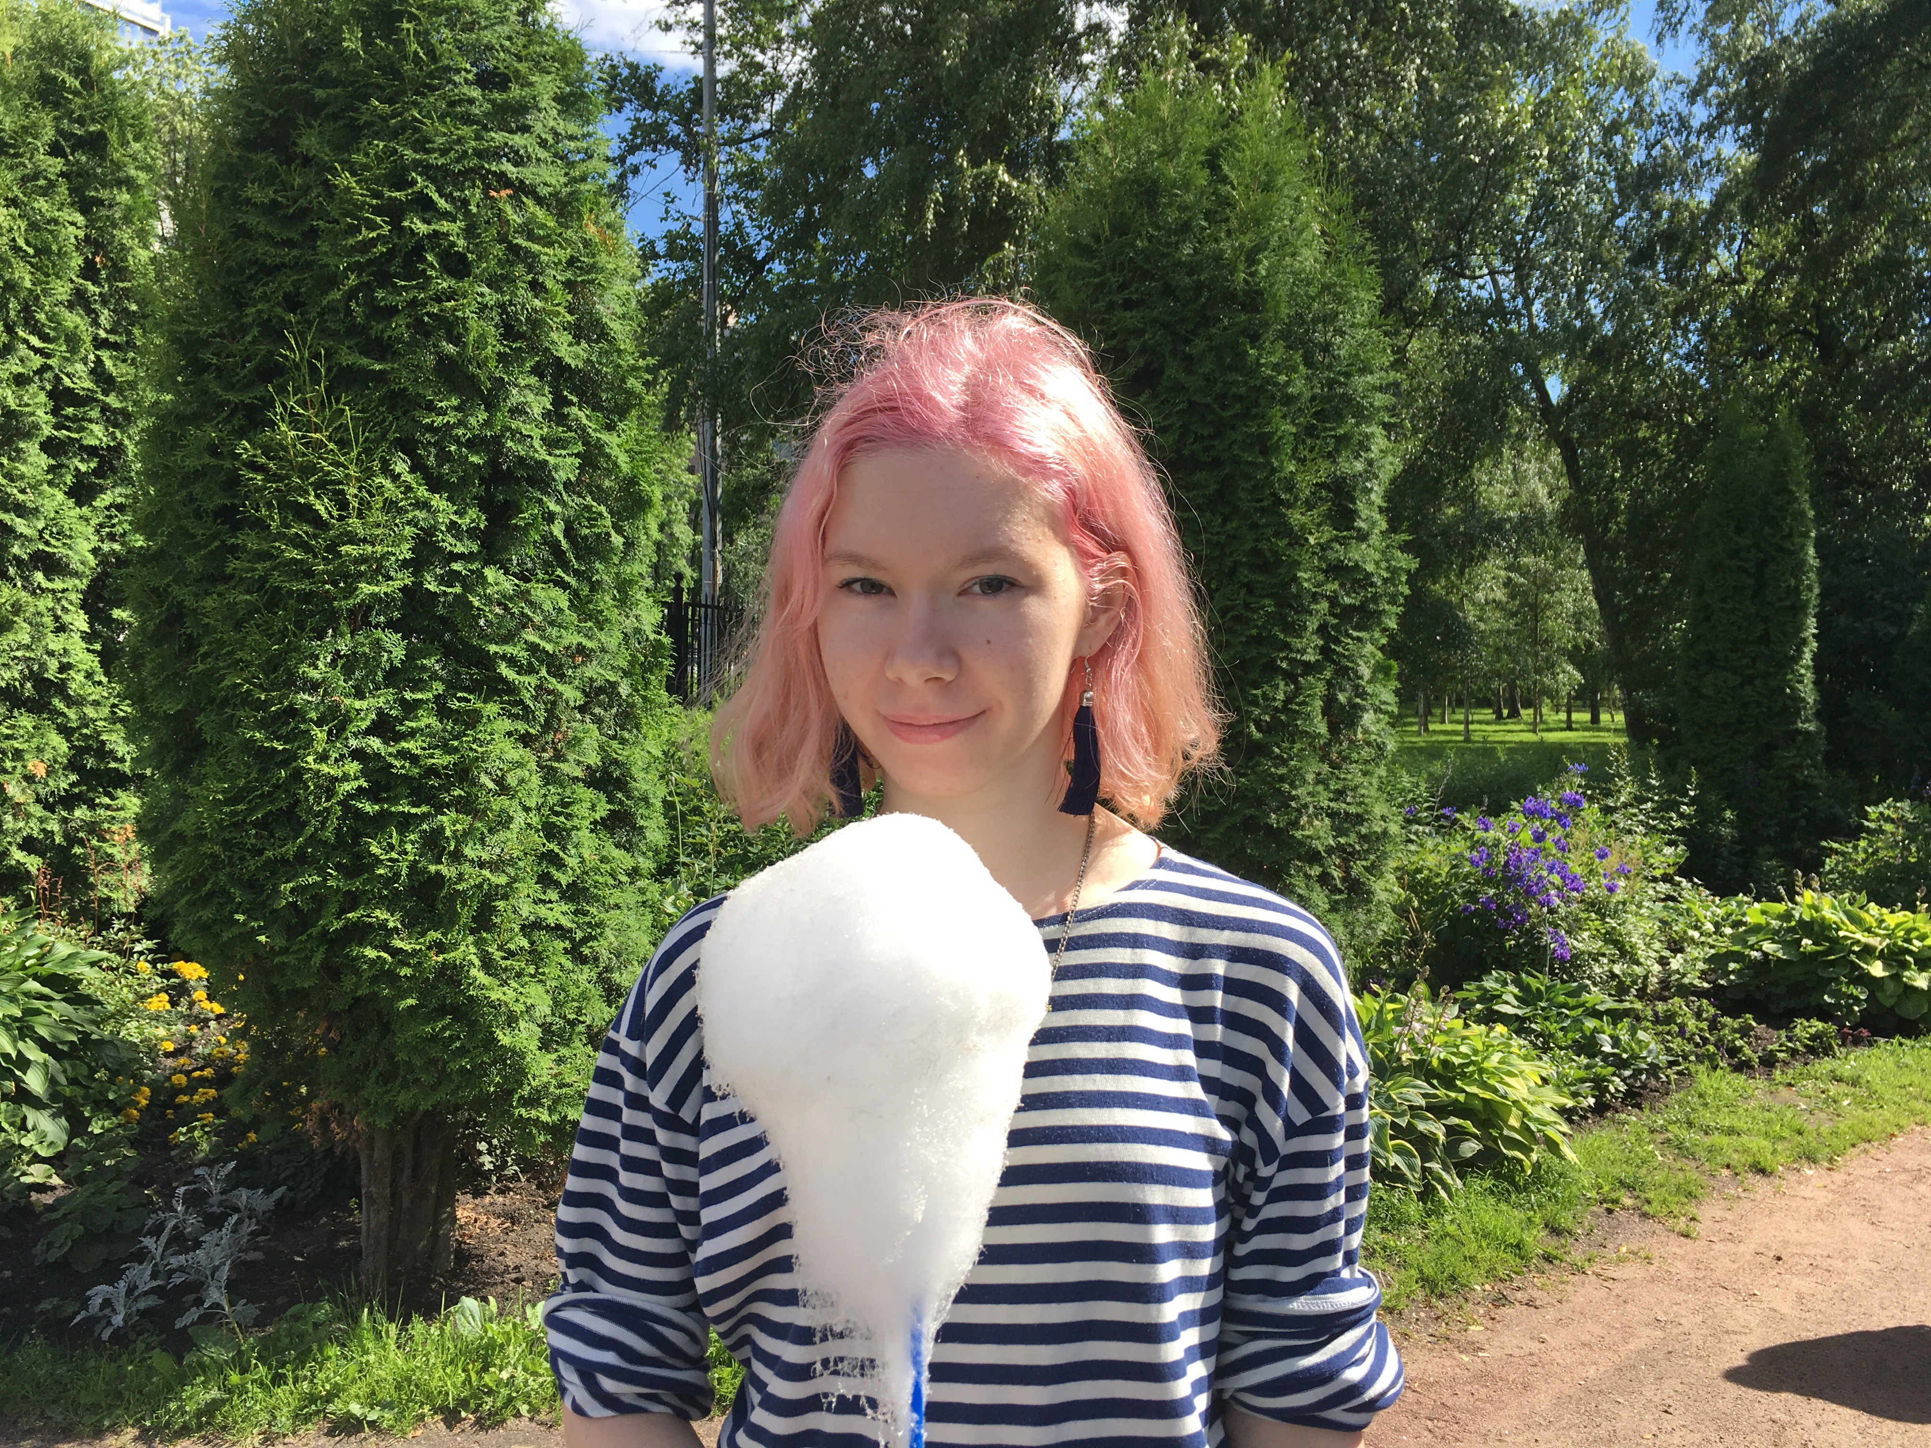
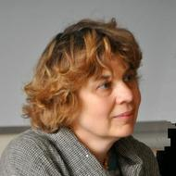
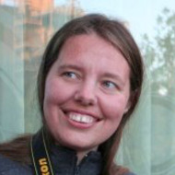
Members of the SMARTool team
Financing and collaboration
Financed by the Norwegian Agency for International Cooperation and Quality Enhancement in Higher Education as a collaboration between UiT the Arctic University of Norway and the Higher School of Economics in Moscow
Radovan Bast
Tore Nesset
Francis Tyers
Mikhail Kopotev
Valentina
Zhukova
Elizaveta
Kibisova
Svetlana Sokolova
Evgeniia Sudarikova
Ekaterina Rakhilina
Olga
Lyashevskaya
James
McDonald

Slide 3
Overview
Strategic targeting of rich inflectional morphology for linguistic analysis and L2 acquisition
Challenges of rich inflectional morphology
Zipfian distribution
“Paradigm Cell Filling Problem”
A data-based model of rich morphology
A machine-learning experiment
The SMARTool
TROLLing for linguistic data
A professionally-curated archive for linguists everywhere

Slide 4
Strategic targeting of rich inflectional morphology for linguistic analysis and L2 acquisition
What I used to believe:
students need to memorize full paradigms in order to achieve fluency
What I now believe:
full paradigms are a fiction and we can strategically target acquisition of morphology

Slide 5
Challenges of rich inflectional morphology
Most languages have rich inflectional morphology
Rich inflectional morphology can involve huge numbers of forms
Inflectional morphology can be complex

Slide 6
Most languages have rich inflectional morphology: A sample from Europe
HIGH | Slavic: Bosnian, Croatian, Czech, Montenegran, Polish, Russian, Rusyn, Serbian, Slovak, Slovene, Sorbian Other Indoeuropean: Albanian, Greek, Irish, Latvian, Lithuanian, Romany, Scottish Gaelic, Welsh Uralic : Estonian, Finnish, Hungarian, Kven, Saami Other: Basque, Maltese, Turkish
MID | Slavic: Bulgarian, Macedonian Other Indoeuropean: Catalan, French, German, Italian, Luxembourgish, Portuguese, Spanish, Yiddish
LOW | Germanic språk: Danish, Dutch, English, Norwegian, Swedish

Slide 7
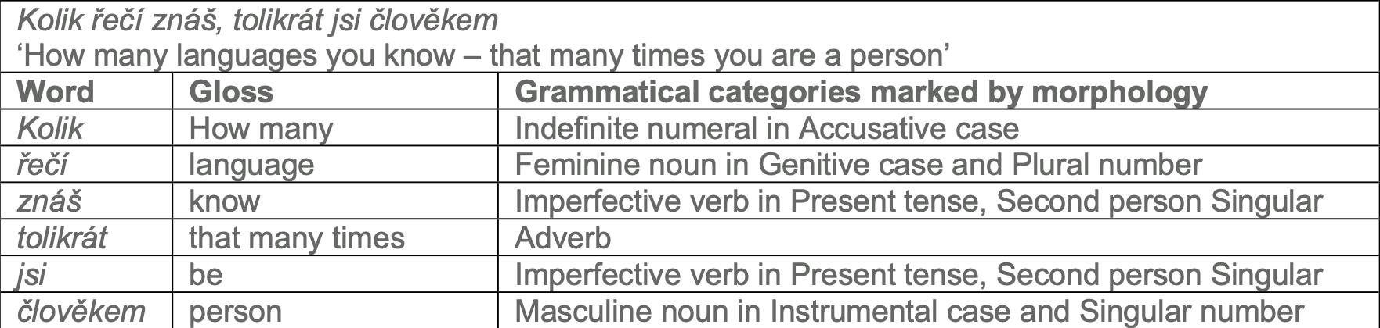
Rich inflectional morphology can involve huge numbers of forms
Inflectional morphology in a Czech proverb
In a language with rich inflectional morphology, even a small basic vocabulary can entail hundreds of thousands of paradigm forms.

Slide 8
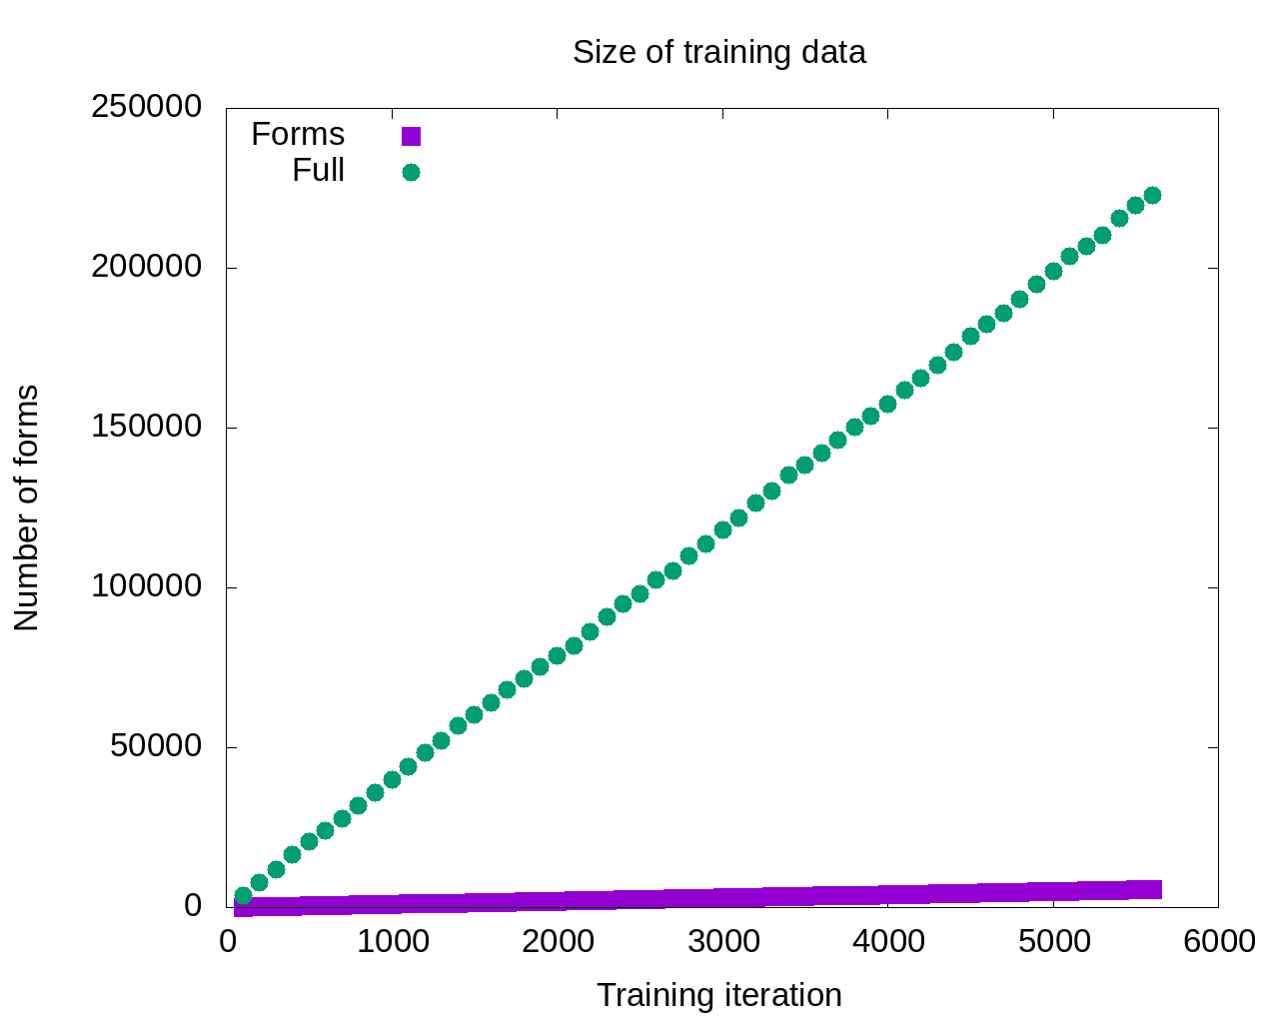
Number of inflected words
Number of paradigm forms

Slide 9
Inflectional morphology can be complex
Morphology is considered both to be essential to L2 acquisition and to be a “bottleneck”, more difficult than both syntax and semantics (Slabakova 2009 & 2014, Jensen et al. 2019)
Morphophonemic alternations can complicate the picture – inflectional morphology is not always a matter of adding desinences to stems
consonant and vowel alternations
fleeting vowels (jers)
suprasegmental alternations

Slide 10
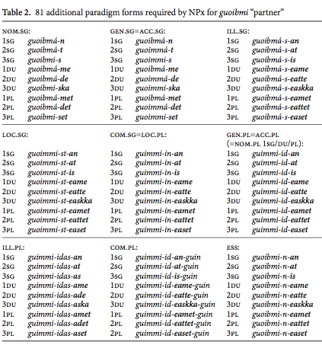
North Saami example
 |  | Basic paradigm of guoibmi “partner”
 |  | nom.sg | guoibmi
 |  | gen.sg=acc.sg | guoimmi
 |  | ill.sg | guoibmá-i
 |  | loc.sg | guoimmi-s
 |  | com.sg=loc.pl | guimmi-in
 |  | nom.pl | guoimmi-t
 |  | gen.pl=acc.pl | guimmi-id
 |  | ill.pl | guimmi-ide
 |  | com.pl | guimmi-iguin
 |  | ess | guoibmi-n

Slide 11
Zipfian distribution
Language & Corpus Name | Corpus Size | Paradigm Size | Total Lexemes | Lexemes with full Paradigm | % Lexemes with full Paradigm
English Web Treebank | 254,830 | 2 | 6,369 | 1,524 | 23.92%
Norwegian Dependency Treebank | 311,277 | 4 | 12,587 | 393 | 3.12%
Russian SynTagRus | 1,032,644 | 12 | 21,945 | 13 | 0.06%
Czech Prague Dependency Treebank | 1,509,242 | 14 | 17,904 | 3 | 0.02%
Estonian ArborEst | 234,351 | 28 | 14,075 | 0 | 0%

Slide 12
Zipfian distribution
Language & Corpus Name | Corpus Size | Paradigm Size | Total Lexemes | Lexemes with full Paradigm | % Lexemes with full Paradigm
English Web Treebank | 254,830 | 2 | 6,369 | 1,524 | 23.92%
Norwegian Dependency Treebank | 311,277 | 4 | 12,587 | 393 | 3.12%
Russian SynTagRus | 1,032,644 | 12 | 21,945 | 13 | 0.06%
Czech Prague Dependency Treebank | 1,509,242 | 14 | 17,904 | 3 | 0.02%
Estonian ArborEst | 234,351 | 28 | 14,075 | 0 | 0%
Because Zipf’s Law scales up, these numbers will never change substantially, no matter how large the corpus is

Slide 13
Language Exposure as a Big Corpus
A large corpus is a close approximation to the lifetime linguistic input for a native speaker, estimated at about 5-10 million words per year
Zipfian distributions remain the same even for very large corpora, like those that approximate a speaker’s exposure to their native language
A native speaker of Russian encounters all twelve paradigm forms of less than 0.1% of nouns that they are exposed to in a lifetime
The portion of adjectives and verbs attested in all paradigm forms is virtually zero.

Slide 14
What this means for words
At the word level, each lemma has a unique “grammatical profile” -- frequency distribution of its paradigm forms

Slide 15
Full paradigms
‘fear’ ‘soldier’ ‘department’ ‘concept’ ‘memory’
sg.nom | страх | солдат | отделение | концепция | память
sg.gen | страха | солдата | отделения | концепции | памяти
sg.dat | страху | солдату | отделению | концепции | памяти
sg.acc | страх | солдата | отделение | концепцию | память
sg.ins | страхом | солдатом | отделением | концепцией | памятью
sg.loc | страхе | солдате | отделении | концепции | памяти
pl.nom | страхи | солдаты | отделения | концепции | памяти
pl.gen | страхов | солдат | отделений | концепций | памятей
p.dat | страхам | солдатам | отделениям | концепциям | памятям
pl.acc | страхи | солдат | отделения | концепции | памяти
pl.ins | страхами | солдатами | отделениями | концепциями | памятями
pl.loc | страхах | солдатах | отделениях | концепциях | памятях

Slide 16
Paradigm forms attested in 1M words
‘fear’ ‘soldier’ ‘department’ ‘concept’ ‘memory’
sg.nom | страх | солдат | отделение | концепция | память
sg.gen | страха | солдата | отделения | концепции | памяти
sg.dat | страху | солдату | отделению | концепции | памяти
sg.acc | страх | солдата | отделение | концепцию | память
sg.ins | страхом | солдатом | отделением | концепцией | памятью
sg.loc | страхе |  | отделении | концепции | памяти
pl.nom | страхи | солдаты | отделения
pl.gen | страхов | солдат | отделений | концепций
p.dat |  | солдатам
pl.acc | страхи | солдат | отделения | концепции
pl.ins | страхами |  | отделениями | концепциями
pl.loc | страхах | солдатах | отделениях
bold >20%, plain >10%, gray 1-9%, (blank) not attested

Slide 17
Full paradigms
‘background’ ‘champion’ ‘expanse’ ‘frame’ ‘problem’
sg.nom | фон | чемпион | протяжение | рамка | трудность
sg.gen | фона | чемпиона | протяжения | рамки | трудности
sg.dat | фону | чемпиону | протяжению | рамке | трудности
sg.acc | фон | чемпионa | протяжение | рамку | трудность
sg.ins | фоном | чемпионом | протяжением | рамкой | трудностью
sg.loc | фоне | чемпионе | протяжении | рамке | трудности
pl.nom | фоны | чемпионы | протяжения | рамки | трудности
pl.gen | фонов | чемпионов | протяжений | рамок | трудностей
p.dat | фонам | чемпионам | протяжениям | рамкам | трудностям
pl.acc | фоны | чемпионов | протяжения | рамки | трудности
pl.ins | фонами | чемпионами | протяжениями | рамками | трудностями
pl.loc | фонах | чемпионах | протяжениях | рамках | трудностях

Slide 18
Paradigm forms attested in 1M words
‘background’ ‘champion’ ‘expanse’ ‘frame’ ‘problem’
sg.nom | фон | чемпион |  |  | трудность
sg.gen | фона | чемпиона |  |  | трудности
sg.dat |  | чемпиону |  |  | трудности
sg.acc |  | чемпионa |  |  | трудность
sg.ins |  | чемпионом |  |  | трудностью
sg.loc | фоне |  | протяжении
pl.nom |  | чемпионы |  | рамки | трудности
pl.gen |  | чемпионов |  | рамок | трудностей
p.dat |  | чемпионам
pl.acc |  | чемпионов |  | рамки | трудности
pl.ins |  | чемпионами |  | рамками | трудностями
pl.loc |  |  |  | рамках | трудностях
bold >20%, plain >10%, gray 1-9%, (blank) not attested

Slide 19
Paradigm Cell Filling Problem (Ackerman et al. 2009)
Native speakers of languages with complex inflectional morphology routinely recognize and produce forms that they have never encountered.
Example:
Russian gerund nedokarmlivaja ‘while underfeeding’ has no attestations in the Russian National Corpus (>360M words ≈ lifetime exposure), but all native speakers of Russian can be expected to readily understand and to produce these forms in appropriate contexts, as evidenced by rare occurrences that turn up in Google searches.

Slide 20
A data-based model of rich morphology
Instead of a table of equiprobable cells:
A multidimensional space that is partially populated in many different ways by many different lexemes
Inflectional morphology can be mastered through exposure to partially overlapping subsets of paradigms
This cognitively plausible model explains why native speakers have the intuition that full paradigms exist

Slide 21
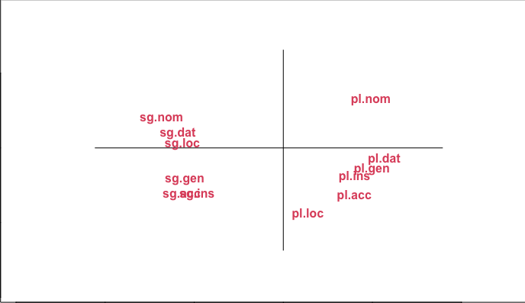
The “space” of the paradigm of Russian masculine animate nouns
as determined by corpus data

Slide 30
Masculine animates

Slide 31
Any single lexeme gives exposure to only a subset of the paradigm.
Each lexeme has a different subset of most typical forms.
Collectively they populate the entire “space” of case/number combinations.
Masculine animates

Slide 32
pl.nom аналитики отмечают
‘analysts make the point that’
The typical wordforms
are motivated by constructions
sg.ins стать/быть чемпионом
‘become/be the champion’
Masculine animates

Slide 33
A machine-learning experiment
Based on an ordered list of the most frequent forms for nouns, verbs, and adjectives in SynTagRus (1M gold standard)
Machine learning: training, testing
Given the 100 most frequent forms, predict the next 100 most frequent forms
Given the 200 most frequent forms, predict the next 100 most frequent forms
Given the 300 most frequent forms, predict the next 100 most frequent forms
… until 5400, when SynTagRus runs out of data
Testing is always: Predict paradigm forms for 100 previously unseen words
Two versions of experiment:
Training on entire paradigm, all forms
Training only on the single most frequent form

Slide 34
Data for training and testing from SynTagRus
Frequency & Form | Lemma | POS | Parse of form
1447 может | мочь | VERB | Aspect=Imp|Mood=Ind|Number=Sing|Person=3|Tense=Pres|VerbForm=Fin|Voice=Act
1286 года | год | NOUN | Animacy=Inan|Case=Gen|Gender=Masc|Number=Sing
999 лет | год | NOUN | Animacy=Inan|Case=Gen|Gender=Masc|Number=Plur
832 году | год | NOUN | Animacy=Inan|Case=Loc|Gender=Masc|Number=Sing
813 время | время | NOUN | Animacy=Inan|Case=Acc|Gender=Neut|Number=Sing
678 россии | россия | NOUN | Animacy=Inan|Case=Gen|Gender=Fem|Number=Sing
571 могут | мочь | VERB | Aspect=Imp|Mood=Ind|Number=Plur|Person=3|Tense=Pres|VerbForm=Fin|Voice=Act
571 люди | человек | NOUN | Animacy=Anim|Case=Nom|Gender=Masc|Number=Plur
543 россии | россия | NOUN | Animacy=Inan|Case=Loc|Gender=Fem|Number=Sing
436 является | являться | VERB | Aspect=Imp|Mood=Ind|Number=Sing|Person=3|Tense=Pres|VerbForm=Fin|Voice=Act
416 случае | случай | NOUN | Animacy=Inan|Case=Loc|Gender=Masc|Number=Sing
411 людей | человек | NOUN | Animacy=Anim|Case=Gen|Gender=Masc|Number=Plur
403 страны | страна | NOUN | Animacy=Inan|Case=Gen|Gender=Fem|Number=Sing
400 жизни | жизнь | NOUN | Animacy=Inan|Case=Gen|Gender=Fem|Number=Sing

Slide 36
So the model that gets the most input should be the most successful, right?

Slide 37
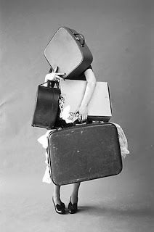
Maybe not…
So the model that gets the most input should be the most successful, right?

Slide 38
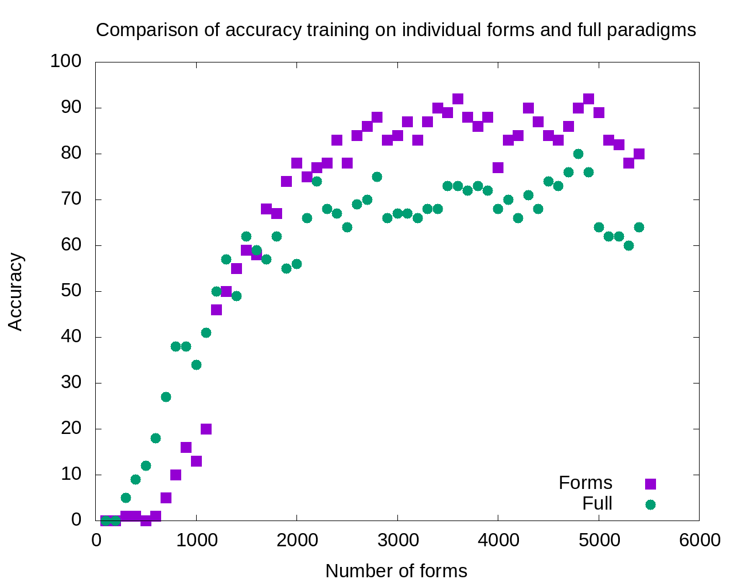
1800-5400:
Single forms model outperforms
full paradigms

Slide 39
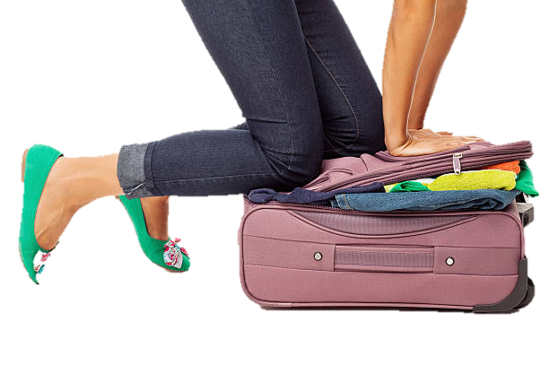
Excess data is probably overpopulating the search domain

Slide 40
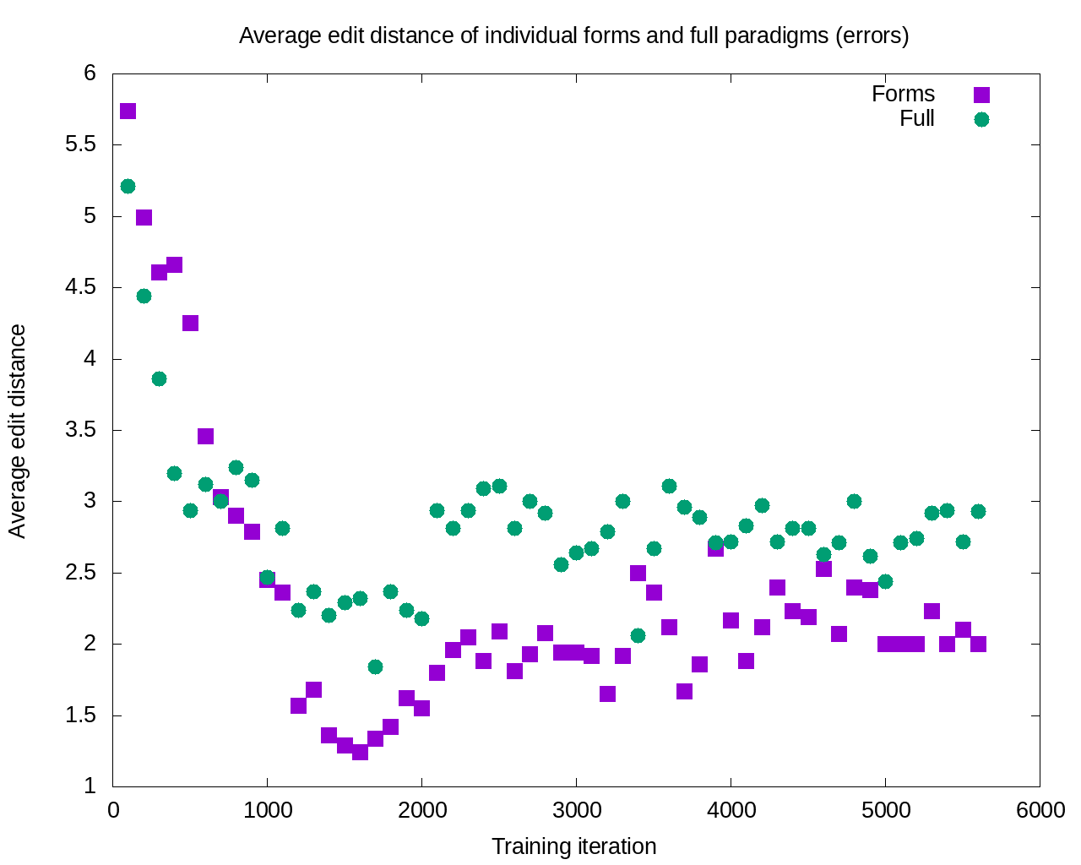
After 11 iterations, the errors committed by the single forms model are consistently smaller

Slide 41
Machine-learning experiment: Summary
Learning is potentially enhanced by focus only on the most typical wordforms attested for each lexeme: accuracy increases and severity of errors decreases
This finding is consistent with a usage-based cognitively plausible model

Slide 42
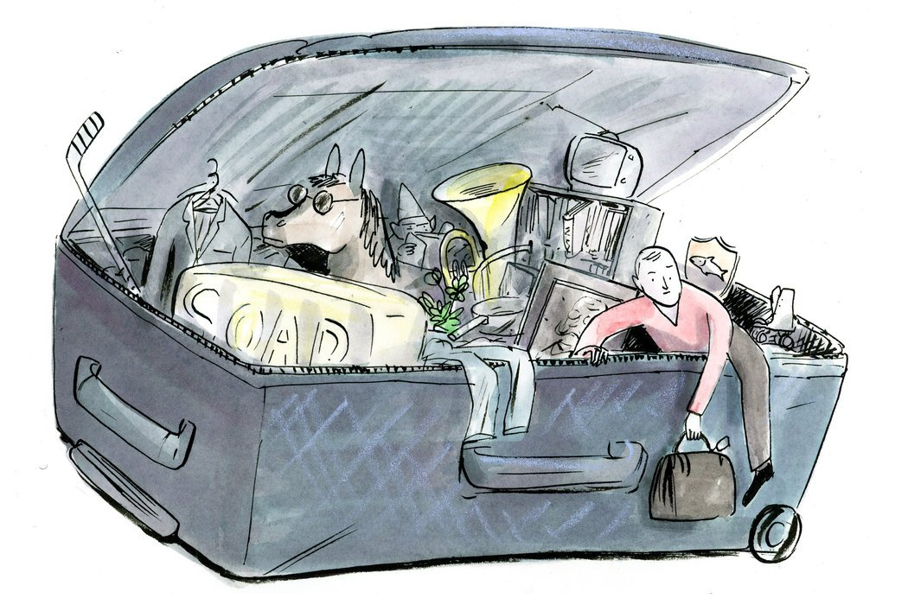
How Can We Escape From Overstuffed Paradigms?
Textbooks have always focused on certain forms and constructions
Now we can do this in a scientific, consistent way

Slide 43
SMARTool = Strategic Mastery of Russian Tool
The SMARTool is available at: http://uit-no.github.io/smartool/
Free web resource for L2 learners of Russian that implements findings of corpus research and a learning simulation experiment to optimize the acquisition of Russian vocabulary and morphology
Partially funded by SIU [Center for Internationalization of Education], now known as DIKU [Norwegian Agency for International Cooperation and Quality Enhancement in Higher Education], in collaboration with the National Research University Higher School of Economics in Moscow

Slide 44
The SMARTool:
Inspired by research on the distribution and simulated learning of Russian wordforms (cognitively plausible)
Strategic focus on the highest frequency wordforms and contexts that motivate their use (usage-based)
Reduces the task of learning a basic vocabulary of about 3,000 lexemes by over 90%
Can be continuously updated and custom-tailored
Potentially portable to other languages with rich inflectional morphology

Slide 45
Vocabulary Selection from 5 Textbooks and Лексический минимум; Balanced for Nouns, Verbs, Adjs (RNC ratio)
CEFR Level | ACTFL Equivalent | Russian Equivalent | SMARTool number of lexemes
A1 “Beginner” | Novice Low-Mid | ТЭУ Элементарный уровень | 500
A2 “Elementary” | Novice High | ТБУ Базовый уровень | 500
B1 “Intermediate” | Intermediate Low-Mid | ТРКИ-1 I Cертификационный уровень | 1,000
B2 “Upper Intermediate” | Intermediate High-Advanced Low | ТРКИ-2 | 1,000

Slide 46

Typical Contexts Illustrated by Examples
For each lexeme we identify 3 most common wordforms and most typical grammatical constructions and lexical collocations, and provide corpus-inspired example sentences
Based on queries:
SynTagRus Corpus
the Russian National Corpus (http://ruscorpora.ru)
the Collocations Colligations Corpora (http://cococo.cosyco.ru/)
the Russian Constructicon (https://constructicon.github.io/russian/)

Slide 47
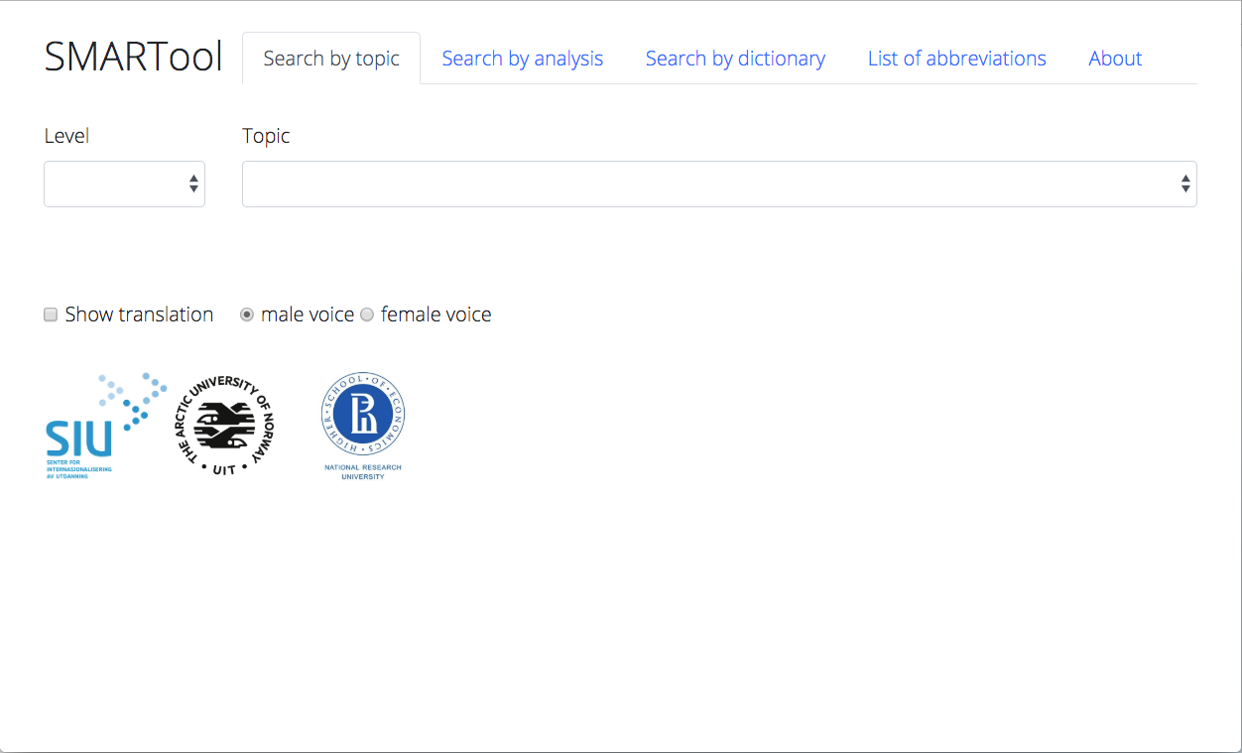
Select a Level
2) Search by topic, analysis, dictionary
Find the SMARTool here:
https://smartool.github.io/smartool/

Slide 48
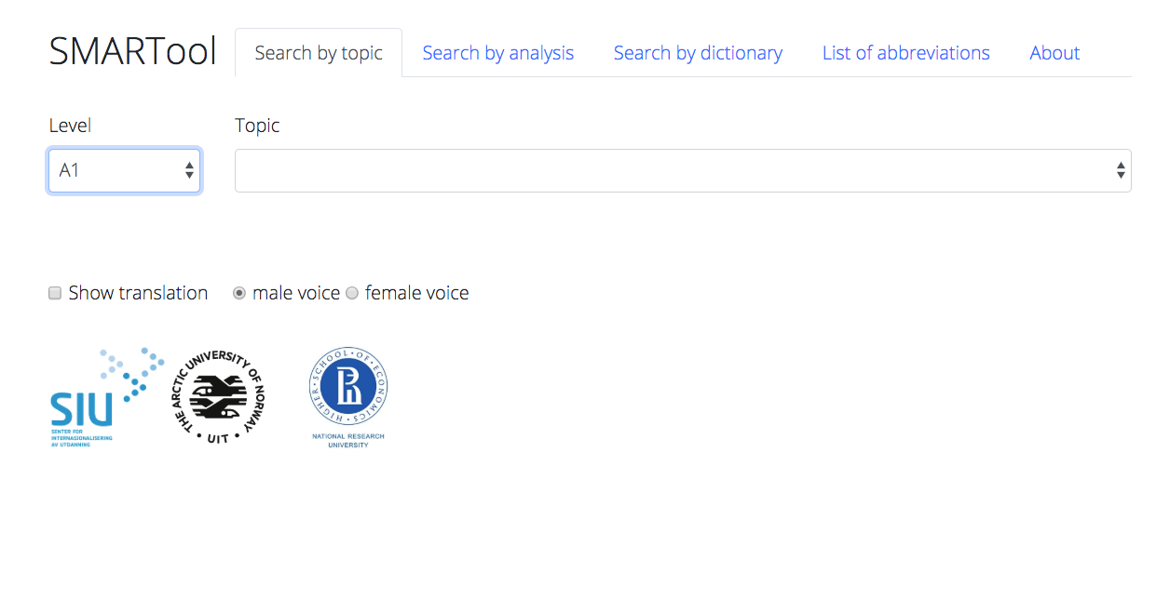

Slide 49
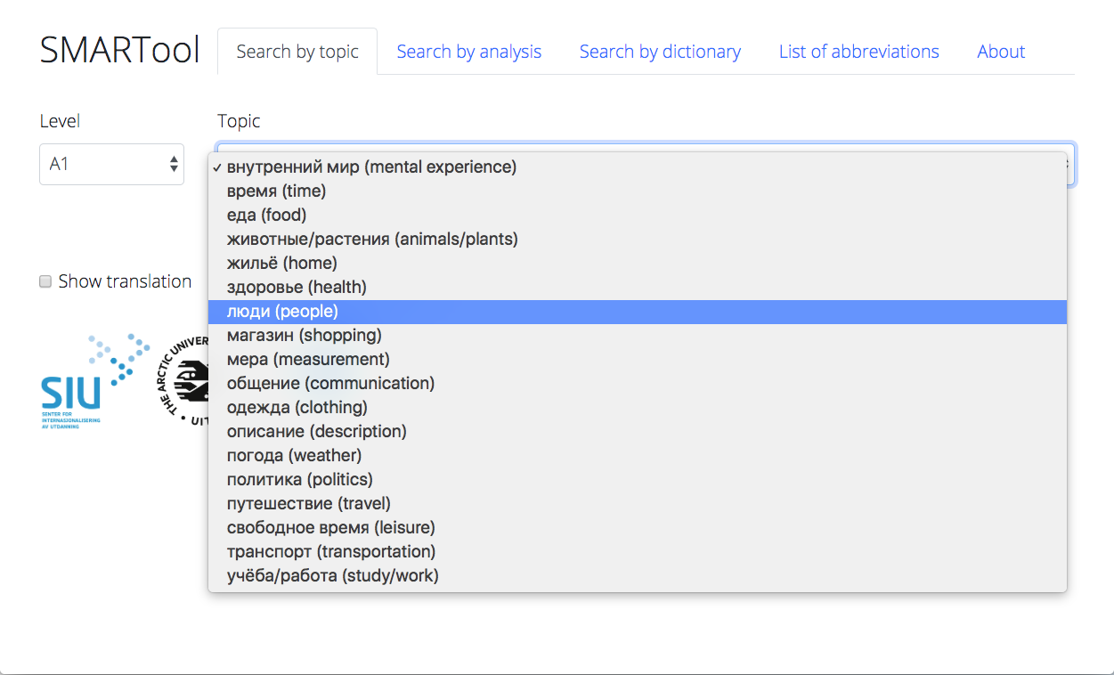

Slide 50
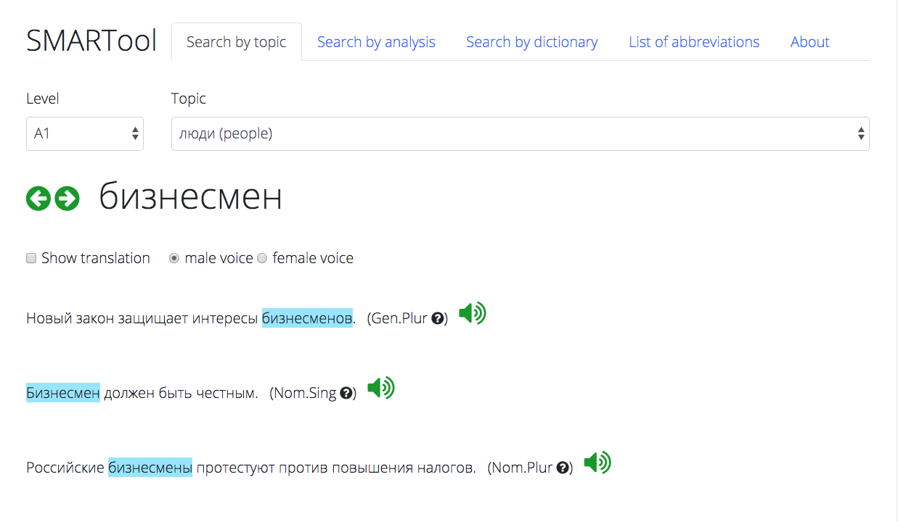

Slide 51
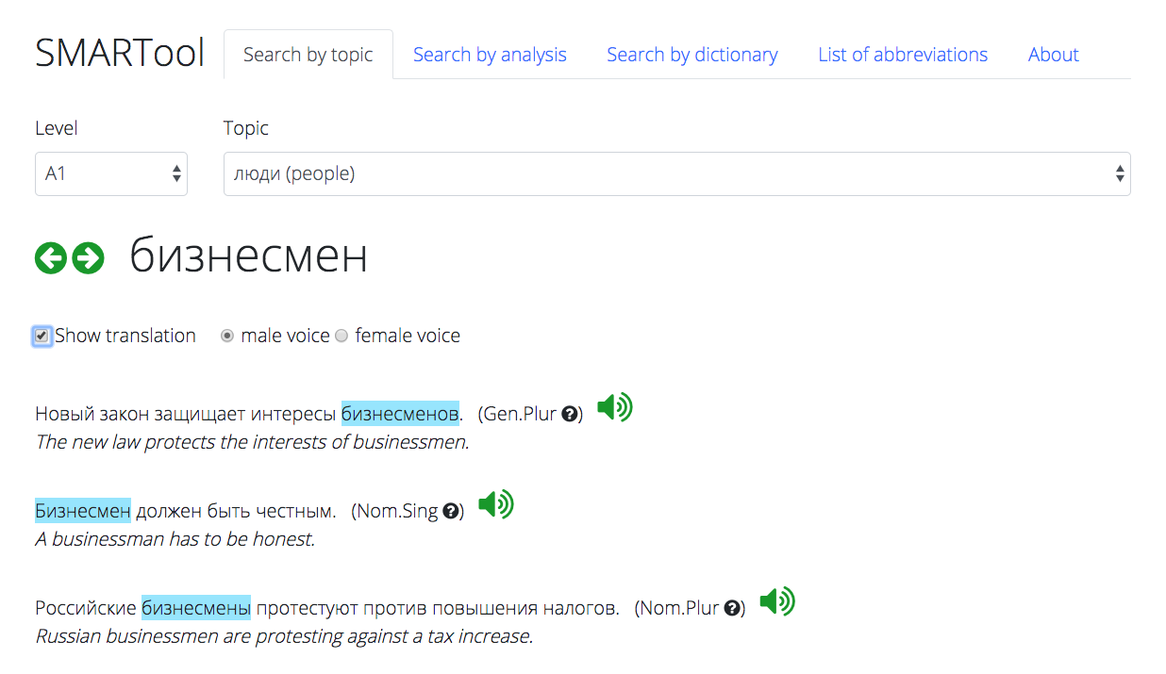

Slide 52
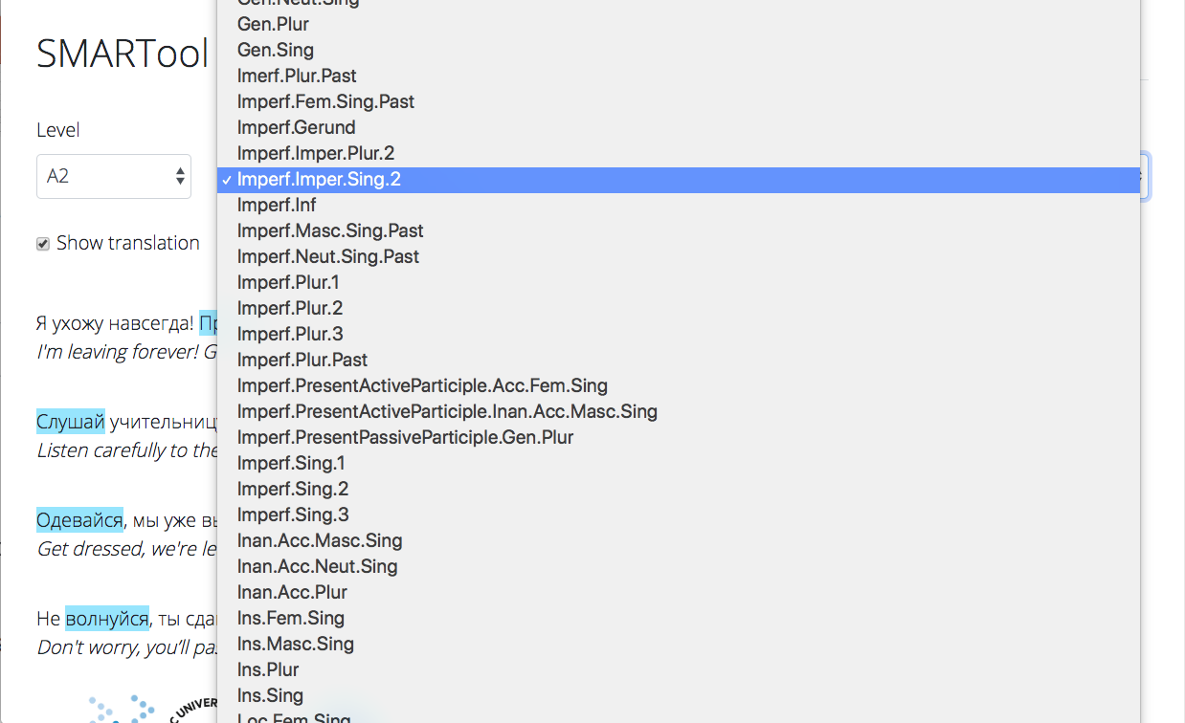

Slide 53
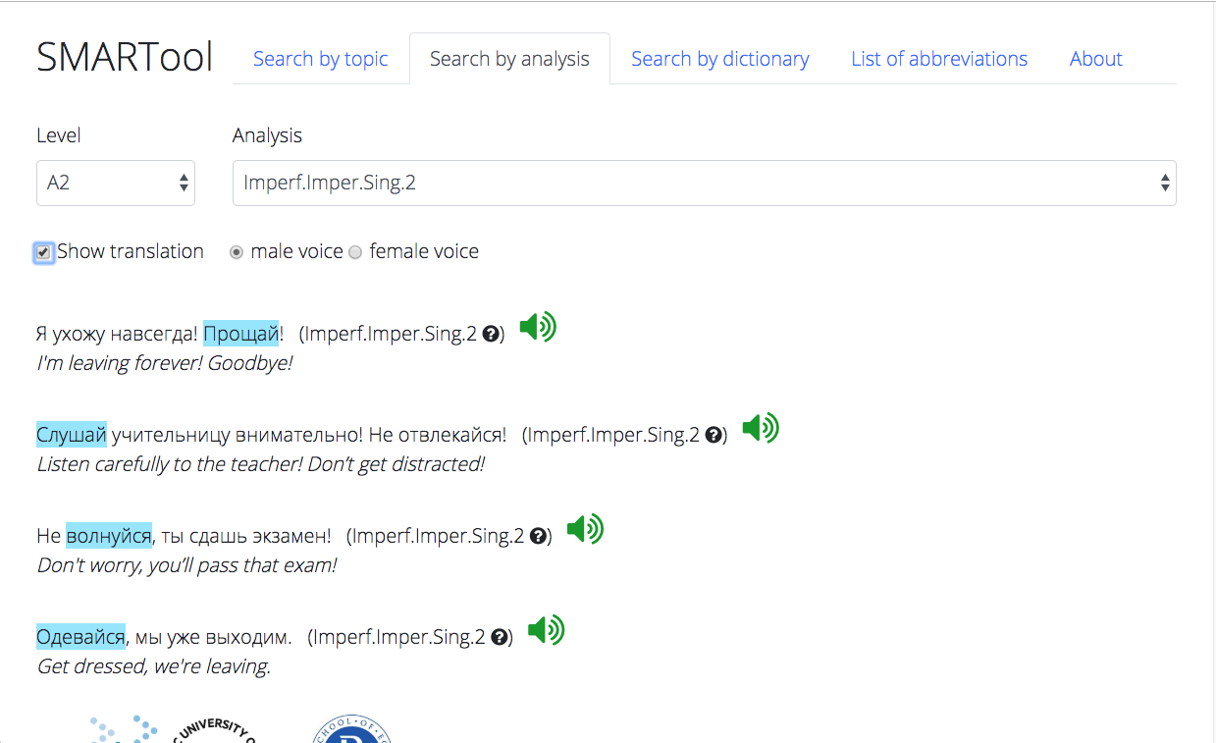

Slide 54
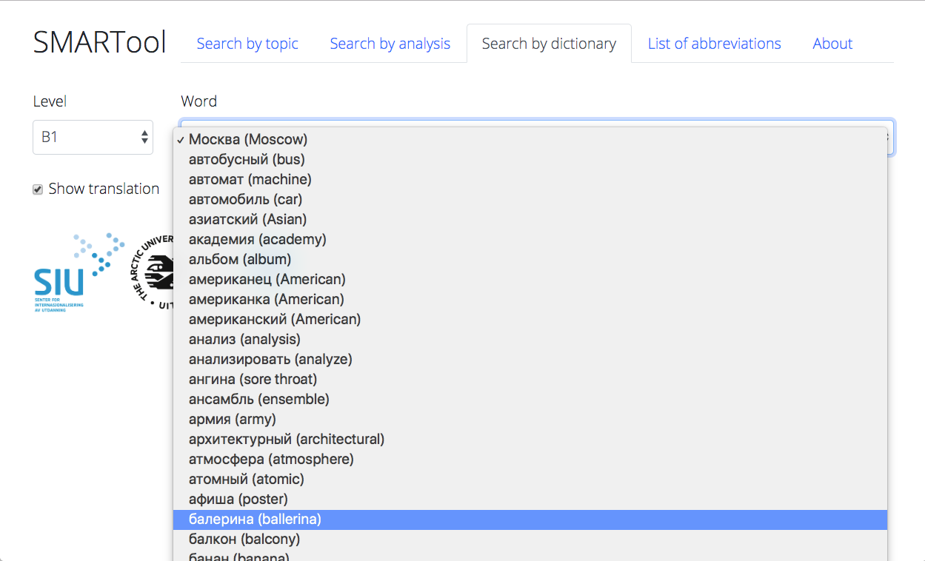

Slide 55
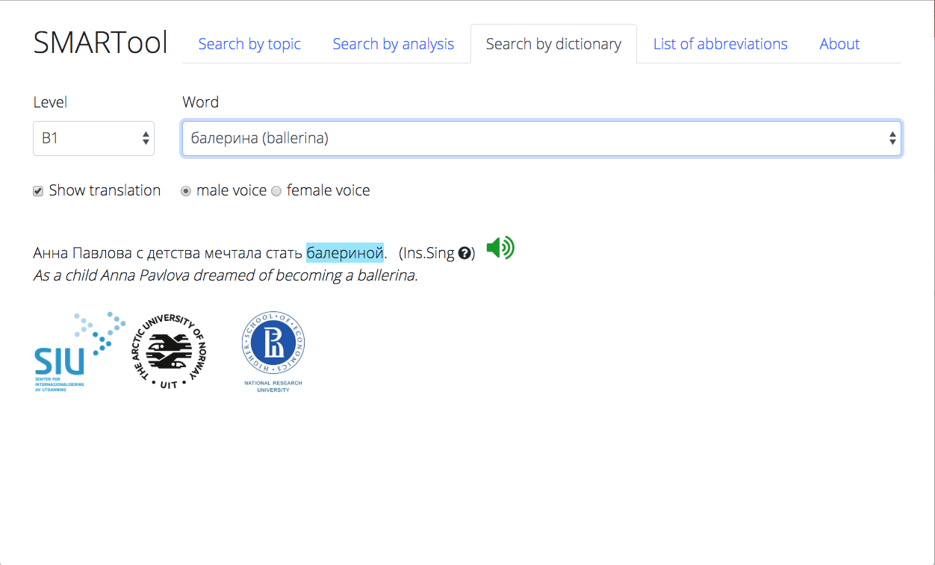

Slide 56
References
Andrjušina, N. P., G. A. Bitextina, L. P. Klobukova, L. N. Norejko, I. V. Odincova (eds.). 2014-2015. Лексический минимум по русскому языку как иностранному. Levels A1-B2. St. Petersburg: Zlatoust.
Baayen, R. Harald. 1992. Quantitative aspects of morphological productivity. In Gert E. Booij and J. Van Marle (eds.), Yearbook of Morphology 1991, 109–149. Dordrecht: Kluwer Academic Publishers.
Baayen, R. Harald. 1993. On frequency, transparency, and productivity. In Gert E. Booij and J. Van Marle (eds.), Yearbook of Morphology 1992, 181–208. Dordrecht: Kluwer Academic Publishers.
Bondar’, N. I. and S. A. Lutin. 2013. Как спросить? Как сказать?, 2nd ed. Moscow: Russkij jazyk.
Černyšov, Stanislav. 2004. Поехали! St. Petersburg: Zlatoust.
Chun, Dorothy, Richard Kern and Bryan Smith. 2016. Technology in language use, language teaching, and language learning. The Modern Language Journal, 100, 64–80. doi:10.1111/modl.12302
Comer, William. 2019. Measured words: Quantifying vocabulary exposure in beginning Russian. Slavic and East European Journal 60, no. 1, 92–114.
deBenedette, Lynne, William J. Comer, Alla Smyslova, Jonathan Perkins. 2013. Между нами (Between You and Me): An Interactive Introduction to Russian. http://www.mezhdunami.org/ (accessed 1 April 2018).
Djačenko, P. V., L. L. Iomdin, A. V. Lazurskij, L. G. Mitjušin, O. Ju. Podlesskaja, V. G. Sizov, T. I. Frolova, L. L. Cinman. 2015. Современное состояние глубоко аннотированного корпуса текстов русского языка (СинТагРус). Сборник «Национальный корпус русского языка: 10 лет проекту». Труды Института русского языка им. В.В. Виноградова. Вып. 6., 272–299.
Endresen, Anna, Laura A. Janda, Robert Reynolds and Francis M. Tyers. 2016. Who needs particles? A challenge to the classification of particles as a part of speech in Russian. Russian Linguistics 40: 2, 103-132. DOI 10.1007/s11185-016-9160-2.
Golonka, Ewa M., Anita R. Bowles, Victor M. Frank, Dorna L. Richardson, Suzanne Freynik. 2014. Technologies for foreign language learning: a review of technology types and their effectiveness. Computer Assisted Language Learning, 27:1, 70–105, DOI: 10.1080/09588221.2012.700315
Hart, Betty and Todd R Risley. 2003. The early catastrophe. The 30 million word gap by age 3. American Educator Spring 2003. 4–9.
Hayes-Harb, Rachel, Jane Hacking. 2015. The influence of written stress marks on native English speakers’ acquisition of Russian lexical stress contrasts. Slavic and East European Journal, 59:1, 91–109.
Hertz, Birgitte, Hanne Leervad, Henrik Lærkes, Henrik Møller, Peter Schousboe. 2001. Свидание в Петербурге. Møde i Petersborg. Copenhagen: Gyldendal.
Janda, Laura A. and Francis M. Tyers. 2018. Less is More: Why All Paradigms are Defective, and Why that is a Good Thing. Corpus Linguistics and Linguistic Theory 14(2), 33pp. doi.org/10.1515/cllt-2018-0031.
Janda, Laura A. Under Submission. Yggur and the power of language: A linguistic invention embedded in a Czech novel.
Kuznetsova, Julia. 2017. The ratio of unique word forms as a measure of creativity. In Anastasia Makarova, Stephen M. Dickey & Dagmar Divjak (eds.), Each Venture a New Beginning: Studies in Honor of Laura A. Janda, 85–97. Bloomington, IN: Slavica Publishers.
Malouf, Robert. 2016. Generating morphological paradigms with a recurrent neural network. San Diego Linguistic Papers. 6. 122–129.
Manning, Christopher D. & Hinrich Schütze. 1999. Foundations of Statistical Natural Language Processing. Cambridge, MA: MIT Press.
Moreno-Sánchez, Isabel, Francesc Font-Clos & Álvaro Corral. 2016. Large-scale analysis of Zipf’s Law in English texts. PLoS One. 11(1). e0147073. 10.1371/journal. pone.0147073.
Robin, Richard, Galina Shatalina, Karen Evans-Romaine. 2012. Голоса (Vols. 1-2), 5th ed. New York: Pearson.
Wade, Terence. 2011. A Comprehensive Russian Grammar, 3rd Edition. Oxford: Wiley-Blackwell.
Zaliznjak, A. A. 1980. Грамматический словарь русского языка. Moscow: Russkij jazyk.
Zipf, George K. 1949. Human Behavior and the Principle of Least Effort. Reading, MA: Addison-Wesley.

Slide 57

A PLACE FOR US:
https://dataverse.no/dataverse/trolling

Slide 58
TROLLing
is an international archive of linguistic data and statistical code
is built on the Dataverse platform from Harvard University and complies with DataCite, the international standard for storing and citing research data
is compliant with CLARIN, the EU research infrastructure for language-based resources
assigns a permanent URL to each post
uses metadata that ensures visability and retrieval through international services
is professionally managed by the University Library of Tromsø and an international steering committee

Slide 59
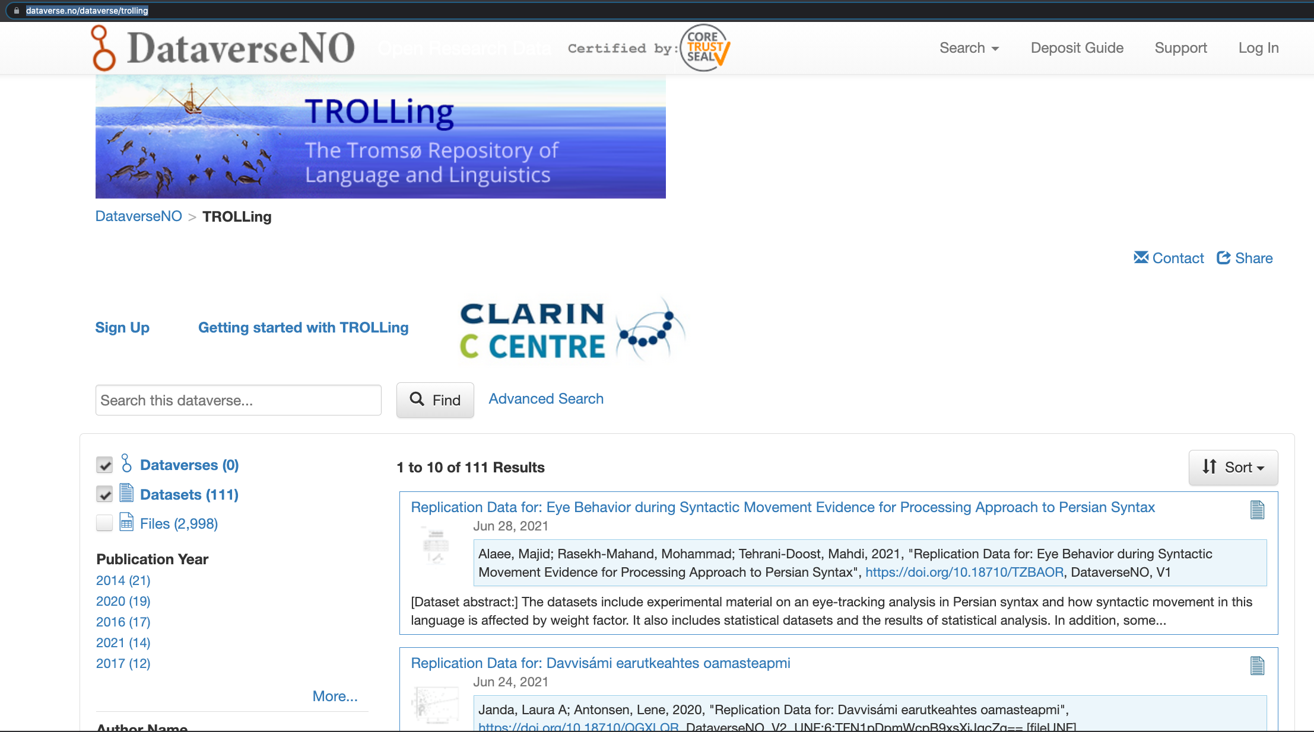

Slide 60
Getting started with TROLLing
http://site.uit.no/trolling/getting-started/
Promotional video
Instructional videos
User guide
TROLLing banner

Slide 61
Basic steps in TROLLing
Create an account
Needed only for archiving -- you do not need an account to search or download data
This step is self-explanatory, but there is an instructional video
It may take a day or two for your account to be approved
Create a study
Enter metadata, upload files in persistent formats, get DOI
Search for a study
TROLLing terms of use

Slide 62
After you have uploaded your study...
You submit it for approval and receive an acknowledgement
It will be approved and released by an administrator and you will receive an email
You will be able to edit your study later if needed and resubmit
Previous versions of your study are archived, but only the latest version shows up in initial searches

Slide 63
Search for a study
All of the cataloging information (metadata) is searchable, including:
author
affiliation
country / nation
date of production and distribution
keywords, e.g. language
topic classification
Advanced search
possible to include and exclude combinations of items

Slide 64
Terms of use that users must agree to when downloading files
Affim that:
You will not use the materials that you downloaded to identify individuals or organizations
You will not download or use materials that would be prohibited by law
You will cite the data as stipulated in the Data Citation Information in any publications or reports that you make using the data
You understand that the distributor makes no warranties about the data

